Slide 1



System Overview
View in Power BI
Last data refresh:
5/26/2024 1:06:01 PM UTC
Downloaded at:
5/27/2024 7:25:32 PM UTC

Slide 2
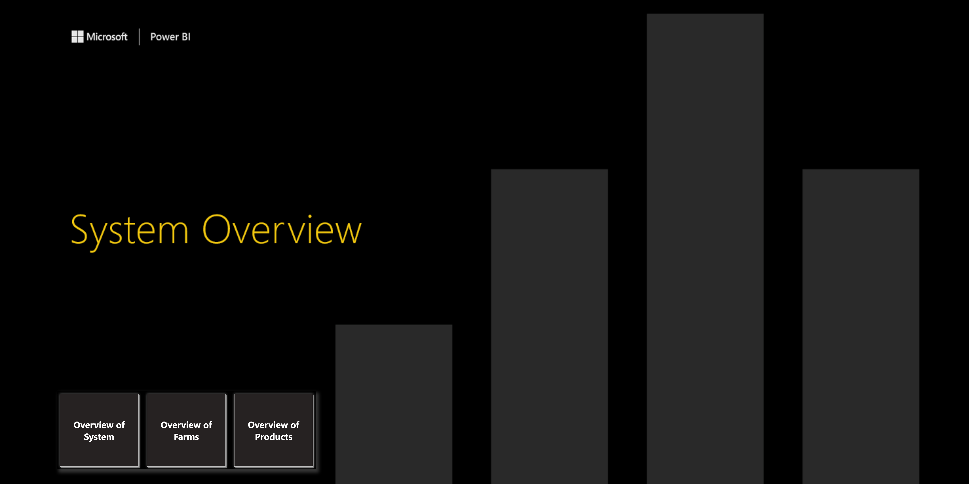
Home Page
Notes:
pageNavigator
No alt text provided

Slide 3
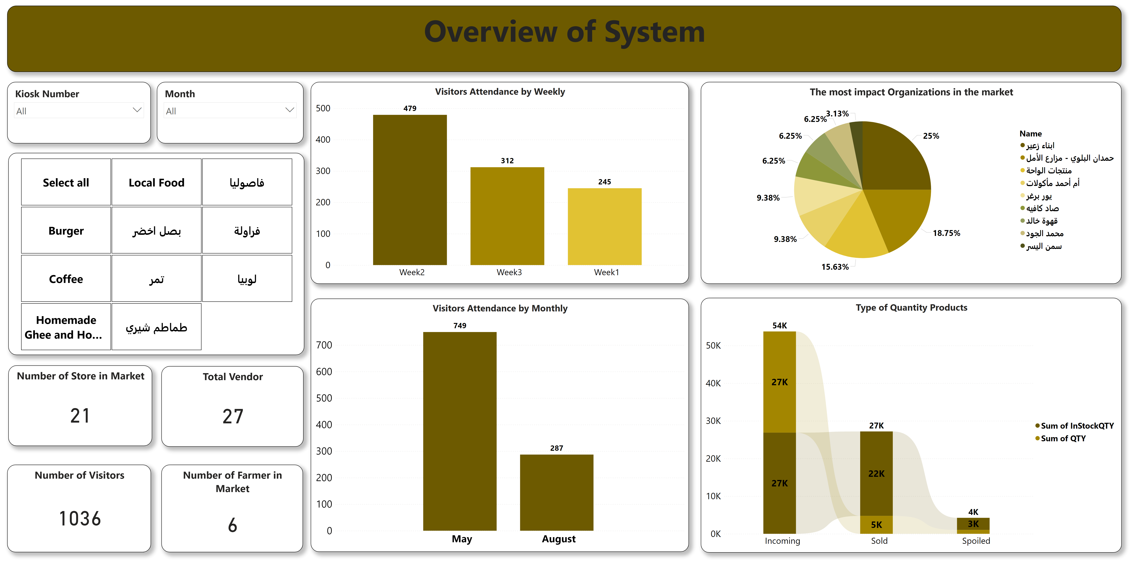
Overview of System
Notes:
slicer
No alt text provided
Total Vendor
No alt text provided
Number of Farmer in Market
No alt text provided
Visitors Attendance by Monthly
No alt text provided
Number of Visitors
No alt text provided
The most impact Organizations in the market
No alt text provided
Type of Quantity Products
No alt text provided
slicer
No alt text provided
Number of Store in Market
No alt text provided
slicer
No alt text provided
Overview of System
No alt text provided
Visitors Attendance by Weekly
No alt text provided
slicer
No alt text provided

Slide 4
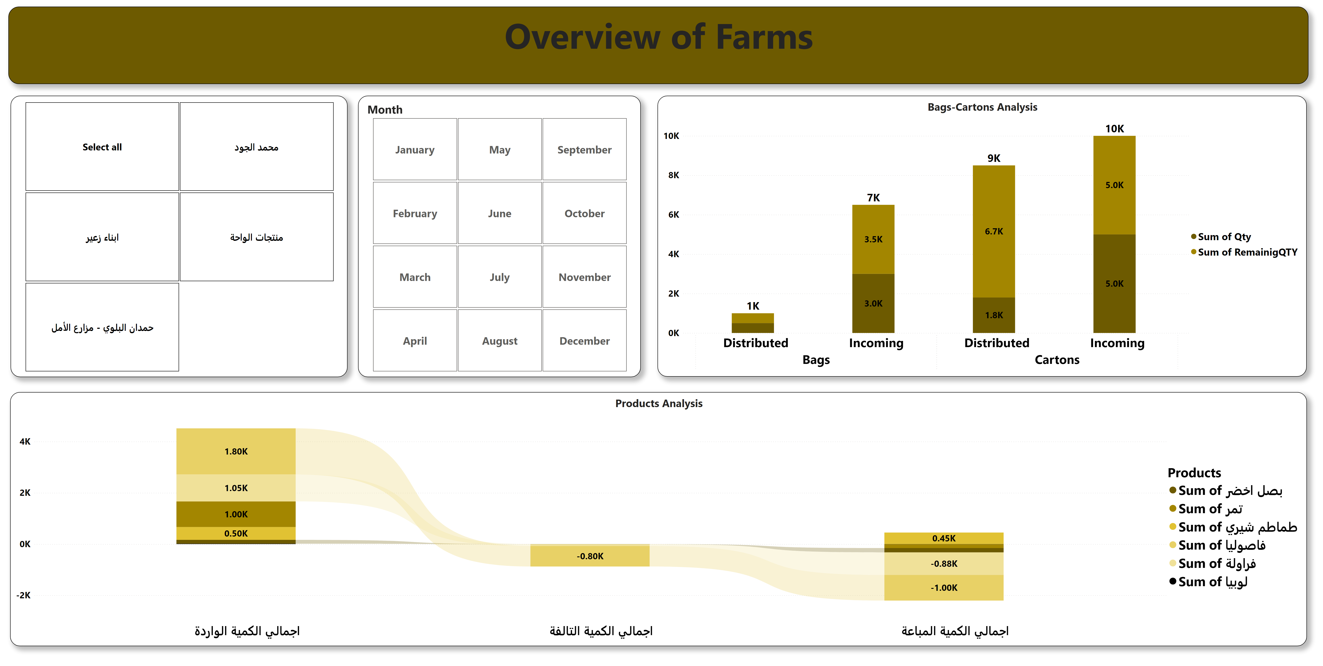
Overview of Farms
Notes:
Bags-Cartons Analysis
No alt text provided
slicer
No alt text provided
Products Analysis
No alt text provided
slicer
No alt text provided
Overview of Farms
No alt text provided
slicer
No alt text provided

Slide 5
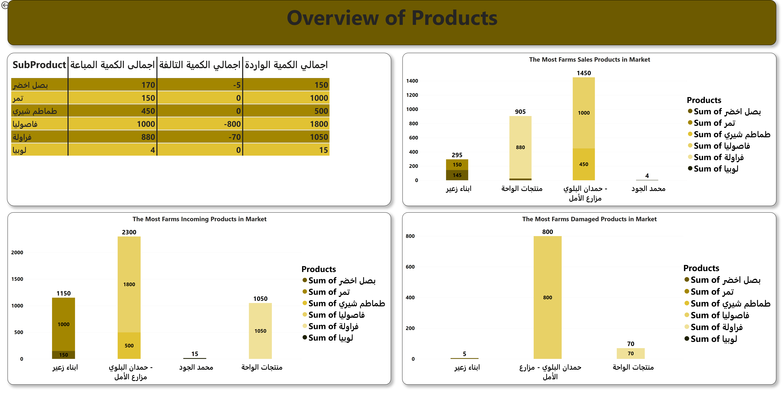
Overview of Products
Notes:
The Most Farms Incoming Products in Market
No alt text provided
The Most Farms Damaged Products in Market
No alt text provided
The Most Farms Sales Products in Market
No alt text provided
Overview of Products
No alt text provided
actionButton
No alt text provided
tableEx
No alt text provided

